Slide 1

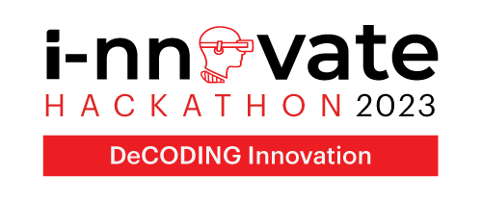
love the new

Slide 2

Table of Contents
Team Details
Problem Statement
What is your idea for the solution?
What domains does it address? What is the impact?
What makes your solution/idea innovative?
Technologies Leveraged
Technical Feasibility
Financial Feasibility
Testimony
Elevator Pitch – 1 to 2 mins

Slide 3
Team Details
Team Name | Member Names | Education Institute Name
SpamBytes | Krishna Aute | Deogiri Institute of Engineering & Management Studies, Aurangabad
 | Shubham Pitekar | Deogiri Institute of Engineering & Management Studies, Aurangabad
 | Dayeeta Chakravorty | Deogiri Institute of Engineering & Management Studies, Aurangabad
 | Siddhi Tribhuwan | Deogiri Institute of Engineering & Management Studies, Aurangabad
 | Samruddhi Giri | Deogiri Institute of Engineering & Management Studies, Aurangabad

Slide 4

Problem Statement
1. Critical E-Waste Levels: India faces a severe challenge with 1.71 million metric tons of electronic waste generated annually.
2. Environmental Urgency: Inadequate e-waste disposal practices have created an alarming environmental problem that demands immediate attention.
3. Locational Difficulties: Individuals and corporations struggle to find reliable e-waste collection facilities, contributing to improper disposal.
4. Impact on Public Health: Improper e-waste disposal not only poses environmental risks but also has implications for public health and safety.
5. Technological Imperative: In a rapidly technologizing world, the correct management of electronic waste is crucial for sustainable development.
6. Need for Systematic Approach: The current scenario emphasizes the urgent requirement for a systematic and accessible approach to e-waste management.
Domain : Sustainability & Green Technology / Environment
Electronic Waste

Slide 5

What is your idea for the solution?
Solution:
In response to the critical issue of e-waste disposal, we present an
Integrated web platform. This solution is characterized by:
User-Friendly Interface: Our platform boasts an intuitive design, ensuring a seamless experience for all users.
Advanced Technology Stack: Leveraging cutting-edge technology, like Nextjs, Expressjs/Nodejs, MongoDB, MapBox map API our platform ensures robust functionality and efficiency.
Key Features:
User Education: Empowering users with knowledge about e-waste disposal best practices.
Booking System: Enables users to easily schedule pickups for their electronic devices, fostering a user-friendly experience.
Location-Based Services- Helps users locate and connect with nearby recycling facilities, promoting accessibility and convenience.
Educational Blog Section- Provides a valuable resource for users to access information about the environmental impact of e-waste and sustainable consumption practices.
Repository of Rules and Regulations- Acts as a centralized source for users to stay informed about the legal frameworks governing e-waste management.
E-Waste Recycling Platform

Slide 6
What domains does it address? What is the impact?
Domains Addressed:
Environmental Sustainability: Mitigates e-waste accumulation through responsible disposal practices and recycling initiatives.
Technology and Innovation: Utilizes cutting-edge technology, such as a user-friendly interface and an interactive chatbot, to revolutionize e-waste management.
Education and Awareness: Emphasizes user education, raising awareness about the importance of proper e-waste disposal and recycling.
Business and Industry: Offers a centralized platform for companies to efficiently manage e-waste disposal processes, supporting sustainable production practices.
Impact:
Environmental: Significantly reduces the environmental impact of e-waste accumulation by promoting responsible disposal practices and recycling, contributing to a more sustainable environment.
Economic: Creates a market for recycled electronic components and fosters responsible production practices, potentially stimulating economic growth.
Transparency and Accountability: Encourages e-waste reporting and auditing, promoting transparency and accountability in waste management efforts.
Empowerment: Empowers individuals and businesses to make informed and responsible choices in e-waste disposal, contributing to a cleaner and more sustainable future.
Innovation and Technology Adoption: By leveraging cutting-edge technology, our solution encourages the adoption of innovative waste management practices.

Slide 7
What makes your Solution/Idea innovative?
Bridging User-Facility Gap:
Fills the crucial gap between users and e-waste facilities, streamlining the disposal process.
Revolutionary E-Waste Booking System:
Introduces a pioneering booking system enabling facilities to verify and issue credits based on valuable metals
in electronic devices.
Real-time Facility Verification:
Utilizes real-time verification processes to ensure facilities meet quality and compliance standards.
Comprehensive Facility Reviews:
Empowers users with essential insights through detailed facility reviews.
Efficient Admin Panel:
Swiftly addresses complaints and offers a comprehensive view with detailed reports.
Sustainable Feedback Loop:
Establishes a feedback loop between users and facilities to encourage continuous improvement and sustainable practices.
Dynamic User Rewards System:
Introduces a dynamic rewards system based on responsible disposal behaviour, fostering long-term user engagement.

Slide 8









Technologies Leveraged
• Frontend Development:
• React/Next.js: Utilized for building the user interface, providing a responsive and interactive experience. And tailwind CSS for styling.
• Backend Development:
• Express.js: Employed to create a robust and efficient backend to handle server-side logic.
• Database Management:
• MongoDB: Chosen for its flexibility and scalability, facilitating efficient data management.
• Geolocation Integration:
• Map Box Maps API: Integrated to enable precise location tracking of nearby e-waste facilities.
• Security Measures:
• Advanced Security Protocols: Employed to safeguard user data and ensure data privacy and integrity.
Tech Stack

Slide 9
Technical Feasibility
Advanced Technology Stack: Utilizes React/Next.js, Express.js, and MongoDB, showcasing a robust and modern tech foundation.
API Integrations: Seamlessly incorporates Google Maps API for precise geolocation of nearby facilities.
Blockchain Integration: Ensures transparent tracking of e-waste, emphasizing data integrity and security.
Real-Time Verification: Capable of verifying facilities in real-time, meeting quality and compliance standards.
Security Measures: Implements advanced protocols for safeguarding user data, ensuring privacy and integrity.
Scalability Considerations: While not explicitly mentioned, the technology choices and architecture suggest potential for scalability with appropriate design considerations.

Slide 10
Financial Feasibility
1. Cost-Effective Technology Stack: By leveraging open-source technologies and frameworks like React/Next.js and Express.js, we keep development costs low while ensuring high-quality performance.
2. Scalable Architecture: The platform's design allows for seamless scaling, minimizing additional infrastructure costs as user base grows.
3. Potential Revenue Streams: Opportunities for revenue generation include premium features, strategic partnerships with e-waste facilities, and potential subscription models for advanced services.
4. Grant and Funding Opportunities: Explore grants and funding programs aimed at supporting sustainable and innovative solutions in the e-waste management sector.
5. Economic Impact: By stimulating a market for recycled electronic components, the platform has the potential to contribute to economic growth in the e-waste recycling industry.
6. Operational Efficiency: Streamlined processes, including real-time verification and AI-powered assessments, optimize resource utilization and contribute to cost efficiency.
7. ROI for Facility Owners: Facility owners can benefit from increased business through the platform, potentially leading to a positive return on investment in their e-waste disposal operations.

Slide 11
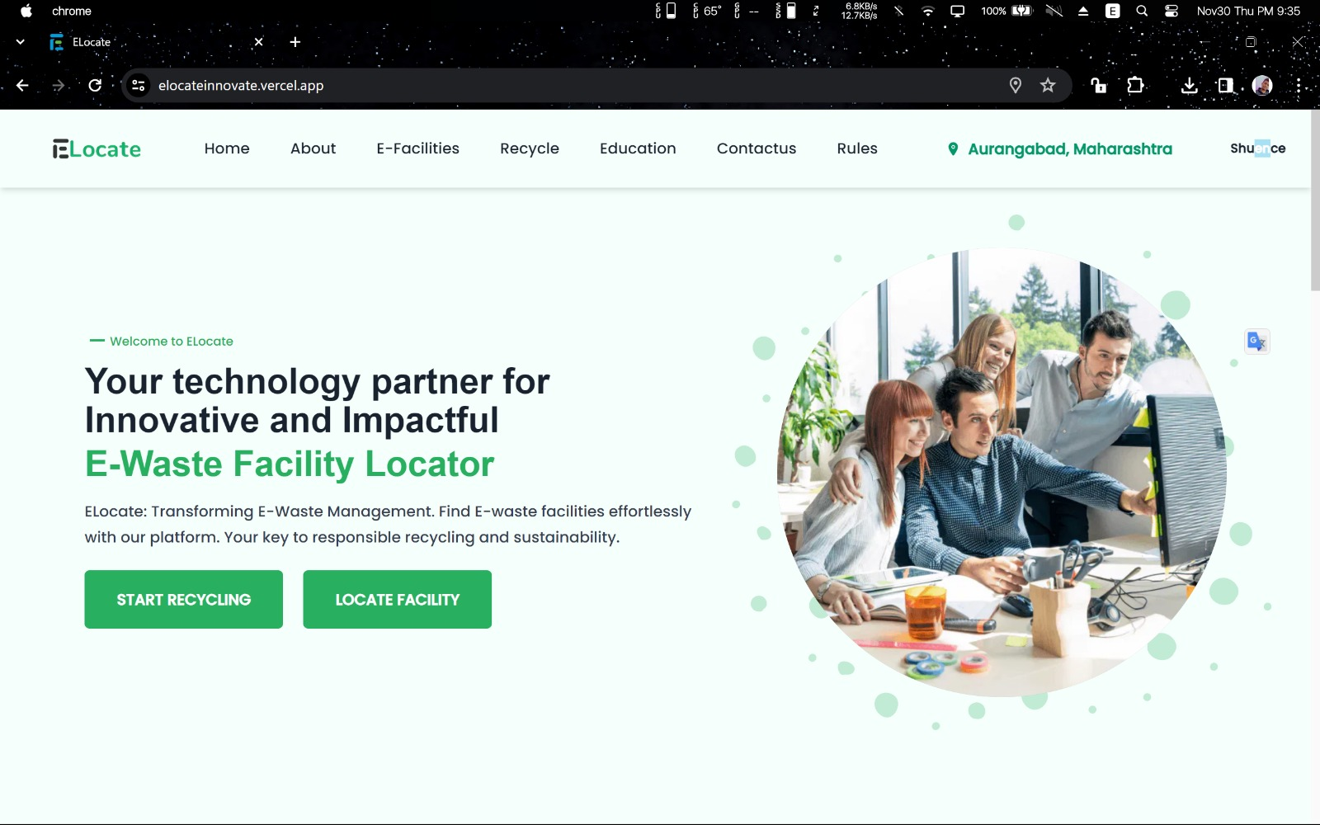

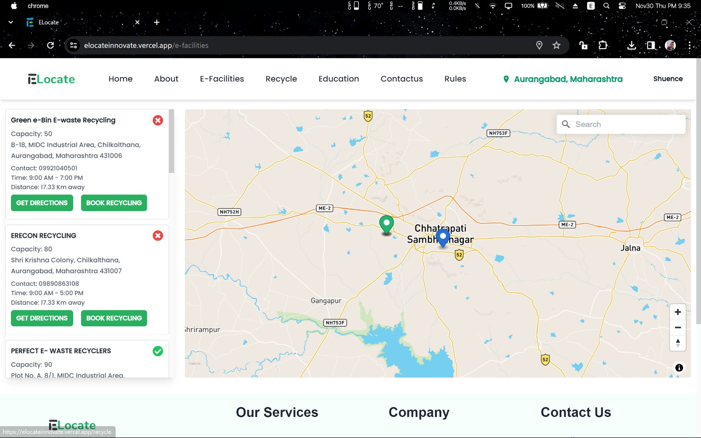
Screen shot of prototype :
https://elocateinnovate.vercel.app

Slide 12
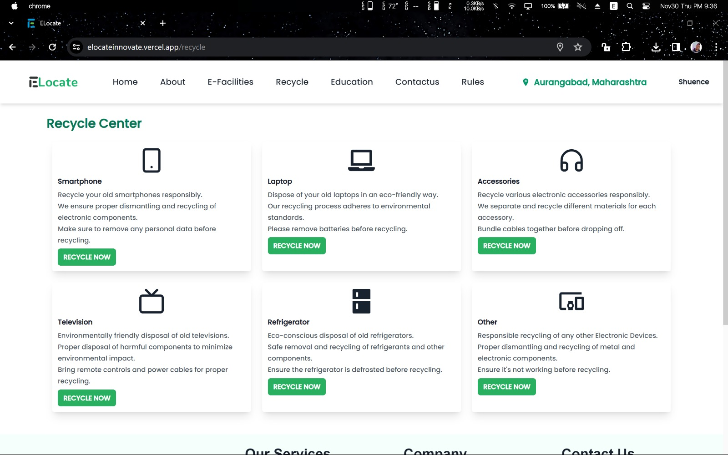
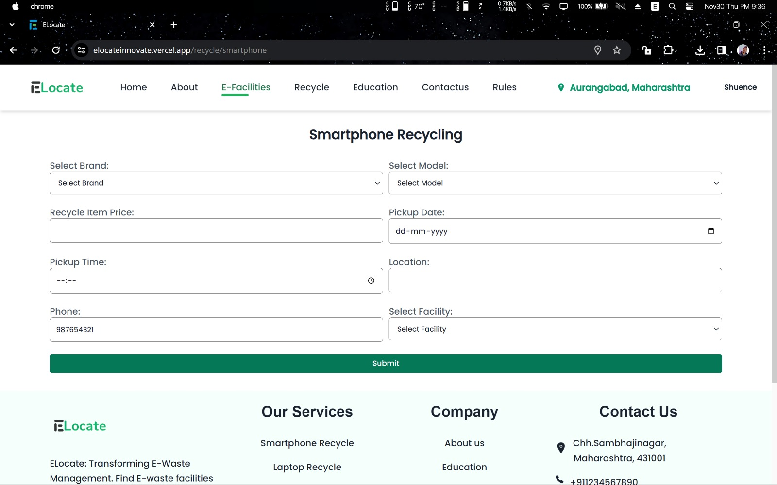

Slide 13
Business Plan
SpamBytes presents the E-Waste Locator Platform, revolutionizing e-waste disposal. Our user-friendly interface and cutting-edge technology bridge the gap between users and e-waste facilities, streamlining the disposal process.
Key Features :
Revolutionary Booking System: Verify and issue credits based on valuable metals in electronic devices.
Real-time Facility Verification: Ensures quality and compliance standards.
Comprehensive Reviews: Empowering users with essential insights.
Efficient Admin Panel: Swiftly resolves concerns for smooth operations.
Impact:
Reduce the environmental impact of e-waste accumulation. Join us in building a cleaner and more sustainable future!
Elevate e-waste management with SpamBytes!

Slide 14
Thank You !

